Slide 1
Bubble tea shop
Capstone Project - The Battle of Neighborhoods (Week 2)

Slide 2
Description of the problem
Bubble tea, which is a popular drink in Asia, attracts more and more customers in European market in recent years. Many Bubble tea brands come to open their stores in France, especially in Paris, which is one of the top touristic destination and receive the visitors around the world each year.
One well-known bubble tea brand wants to enter this potential market in Paris and looks for a good location to set up their shop. The criteria for the decision are:
1. Not far from the center of Paris
2. Not far from famous attractions
3. Having less existing bubble tea shops
We will analyze which neighborhood is the best place for him to open his store.
The audience of this project could be the investor or bubble tea shops owner or anyone who wants to research about this market.

Slide 3
Description of the data
First of all, we will search for some popular attractions in Paris and list them down. Then, we will use Foursquare API to extract all the Bubble tea shops in Paris. After that, we will cluster those bubble tea shops according to their GPS coordinates (latitudes and longitudes) by making the attractions as their centroids. At the end, we could suggestion which cluster has the less existing shops and near which attraction.

Slide 4
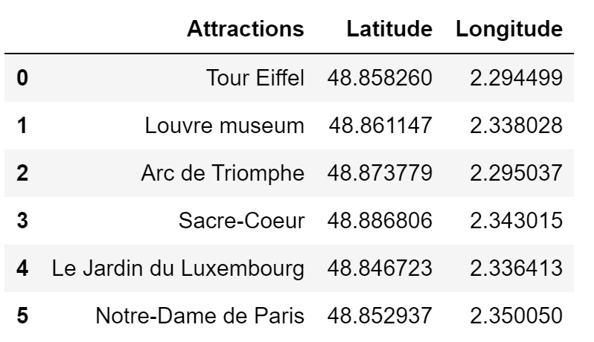
Methodology
List Paris top attractions and convert into pandas data frame.

Slide 5
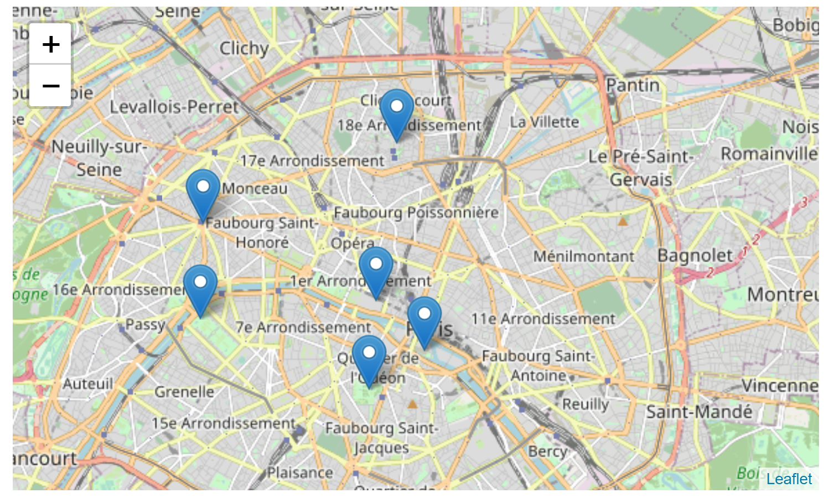

Slide 6
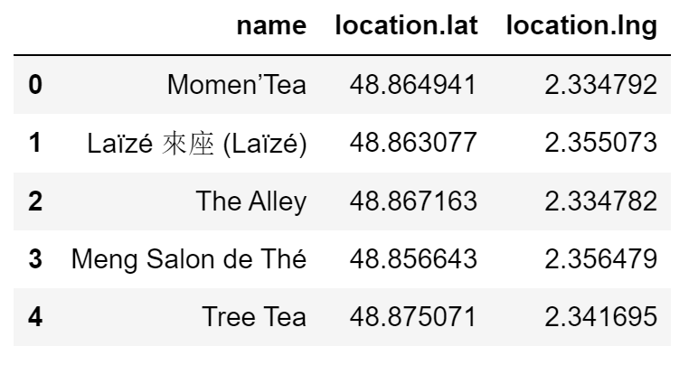
Extract the shops from Foursquare API

Slide 7
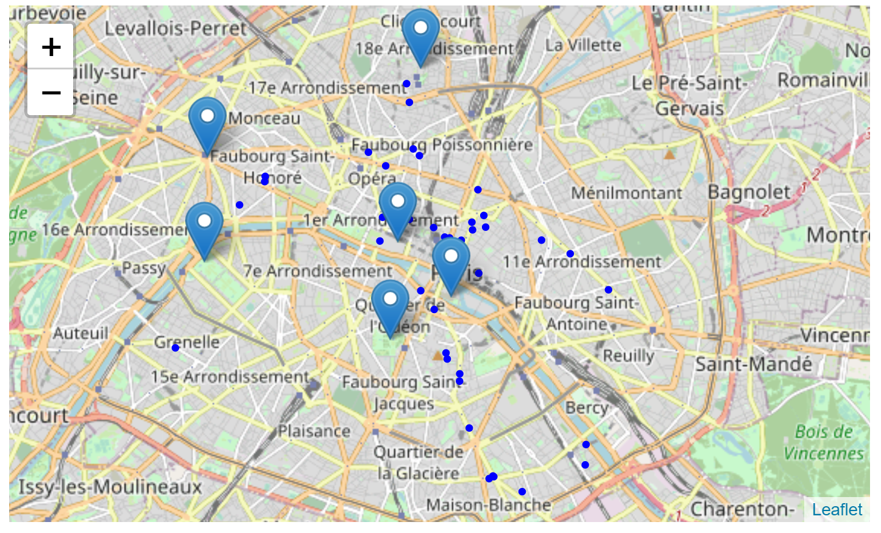

Slide 8
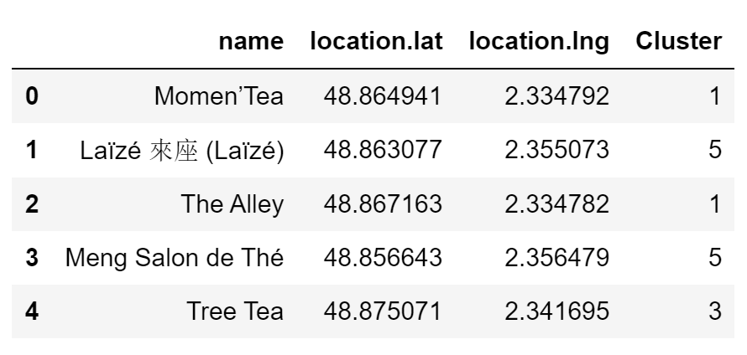
Result

Slide 9
Result
Cluster | Color | Number of shops
5 | Orange | 20
1 | Purple | 14
3 | Light blue | 5
4 | Green | 4
2 | Blue | 3
0 | Red | 1

Slide 10
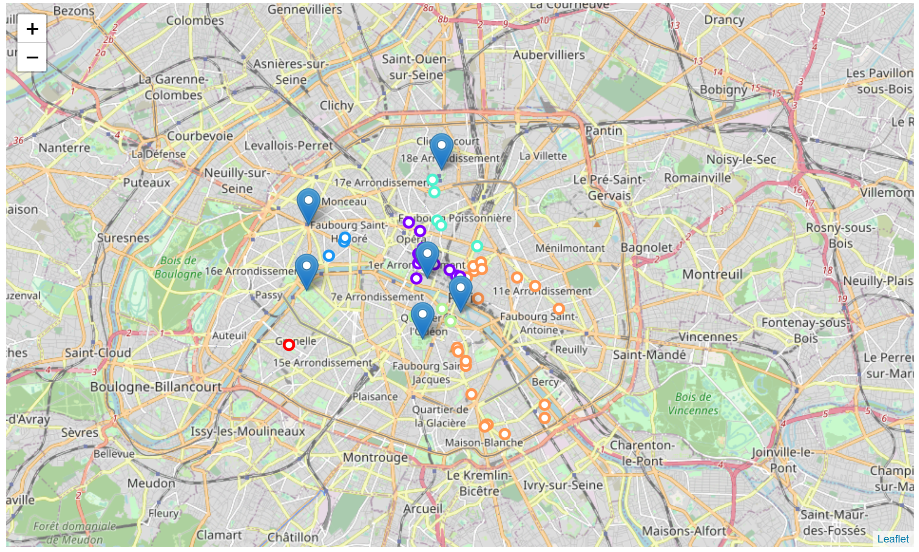

Slide 11
Discussion
According the result above, we could say that there are many bubble tea shops existing in the center of Paris, especially in the locations nearby Notre-Dame de Paris and Louvre Museum. However, there are few bubble tea shop around Arc de Triomphe and Tour Eiffel.

Slide 12
Conclusion
In conclusion, the investor should look for the location around Arc de Triomphe or Tour Eiffel. They are both the most famous monuments in Paris and the top destinations in Paris for tourists. In addition, there are still not many bubble tea shop opened yet, so this location should be considered.

